Slide 1
The first major topic in this chapter concerns the characteristics of this energy
outside the earth’s atmosphere
The second major topic in this chapter is solar geometry
The third topic is extraterrestrial radiation on a horizontal surface

Slide 2
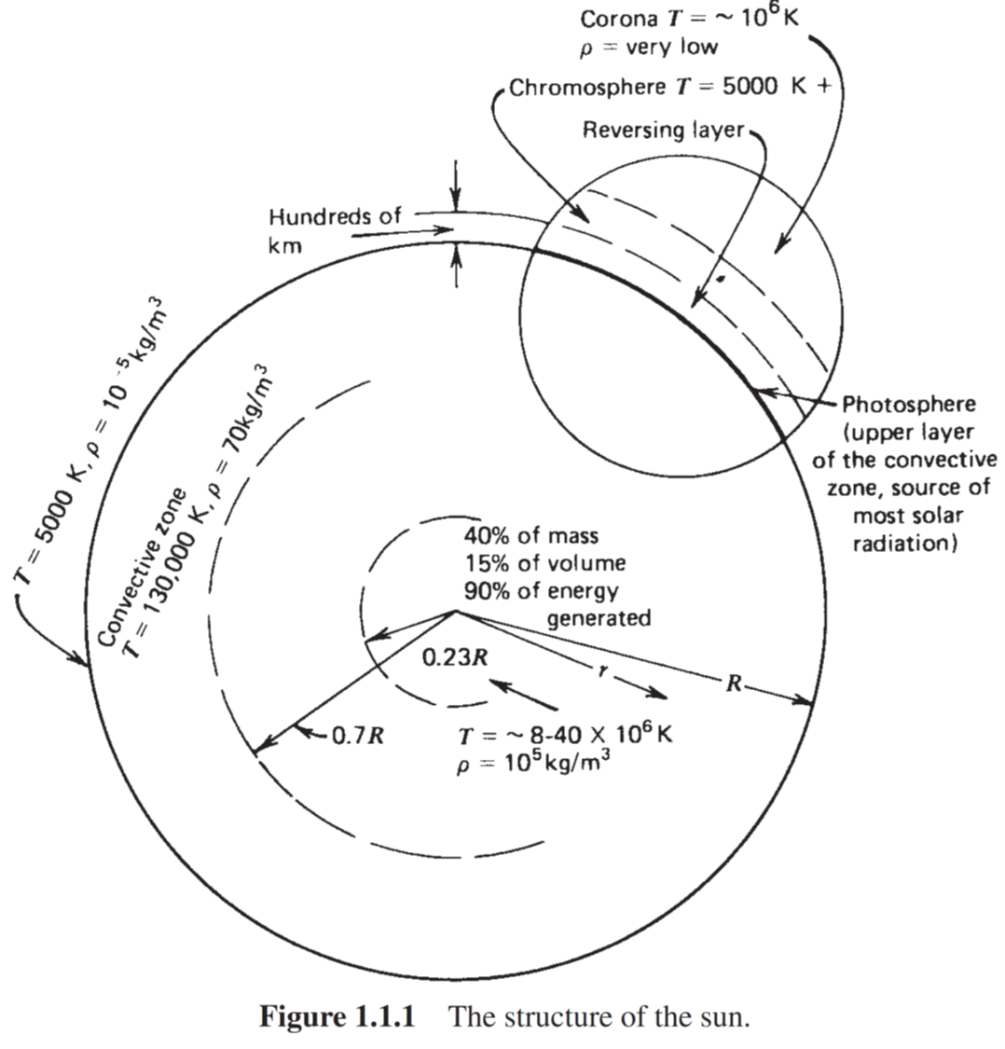
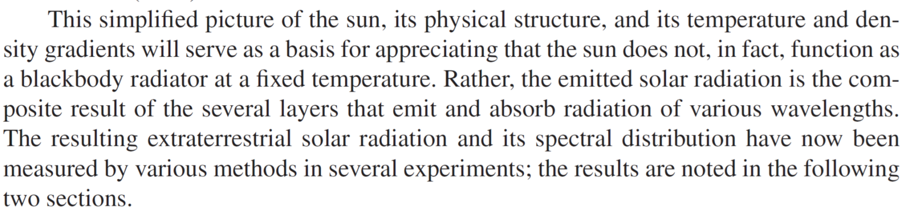
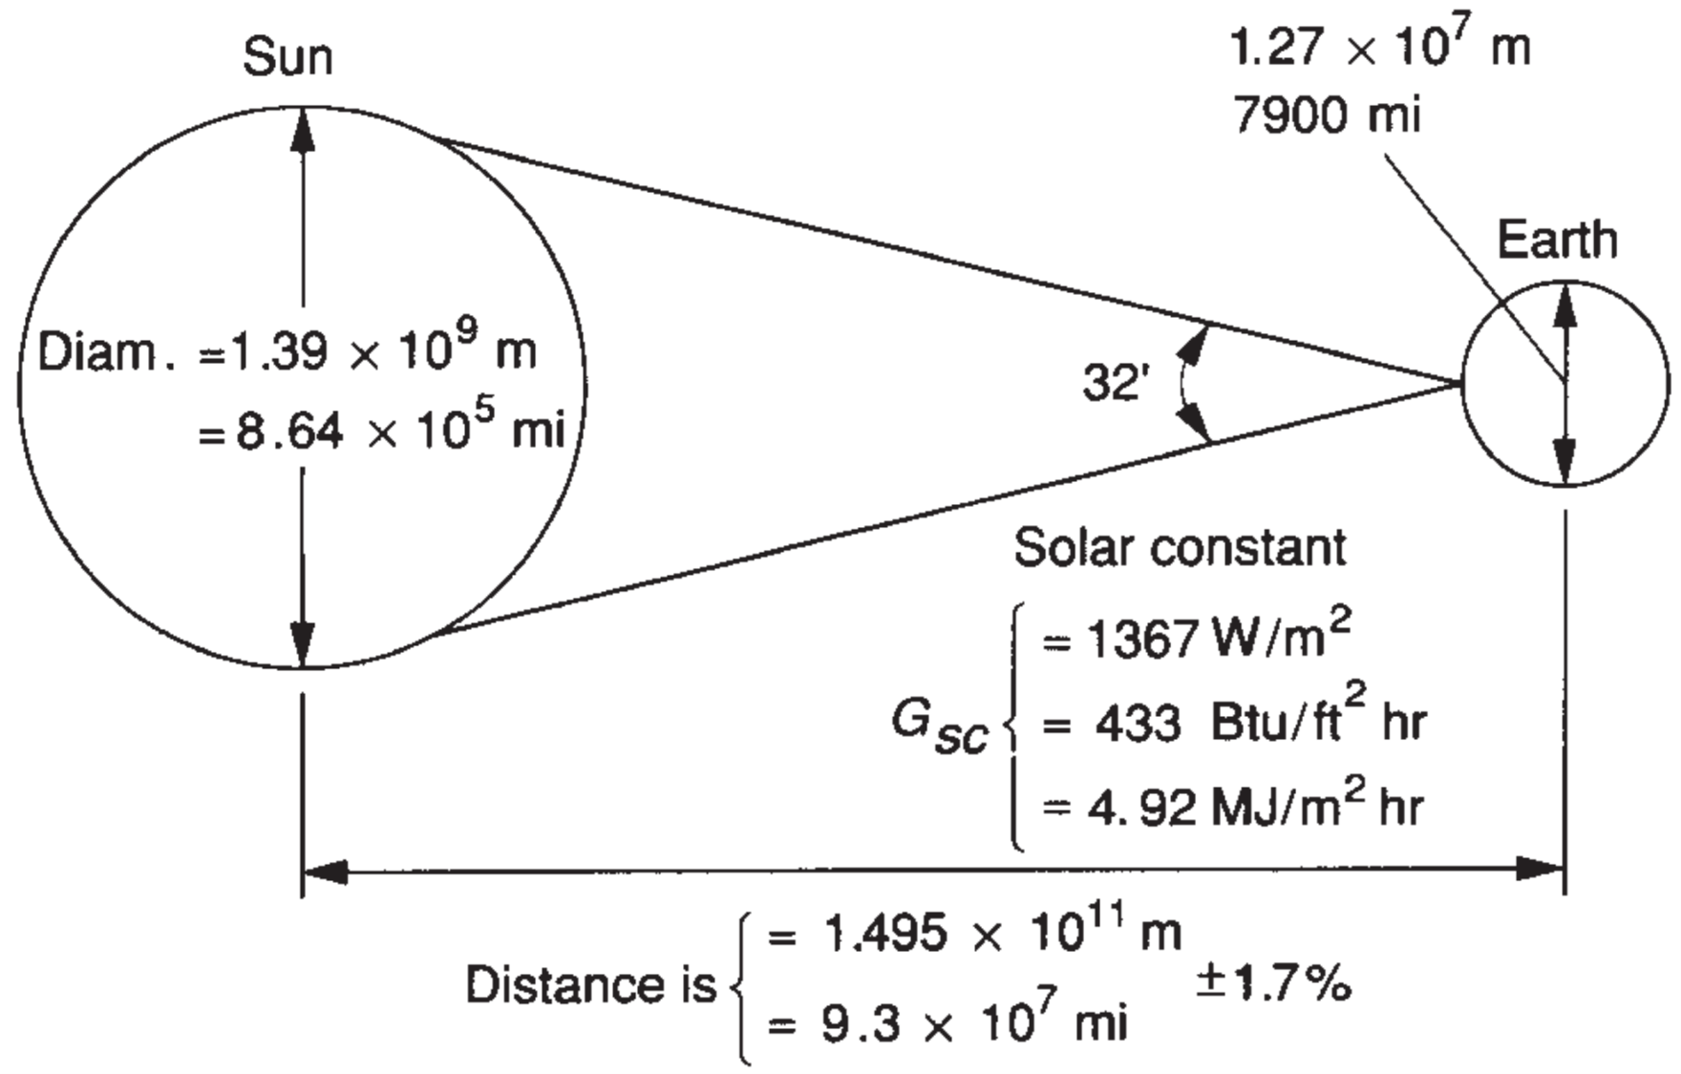

Slide 3
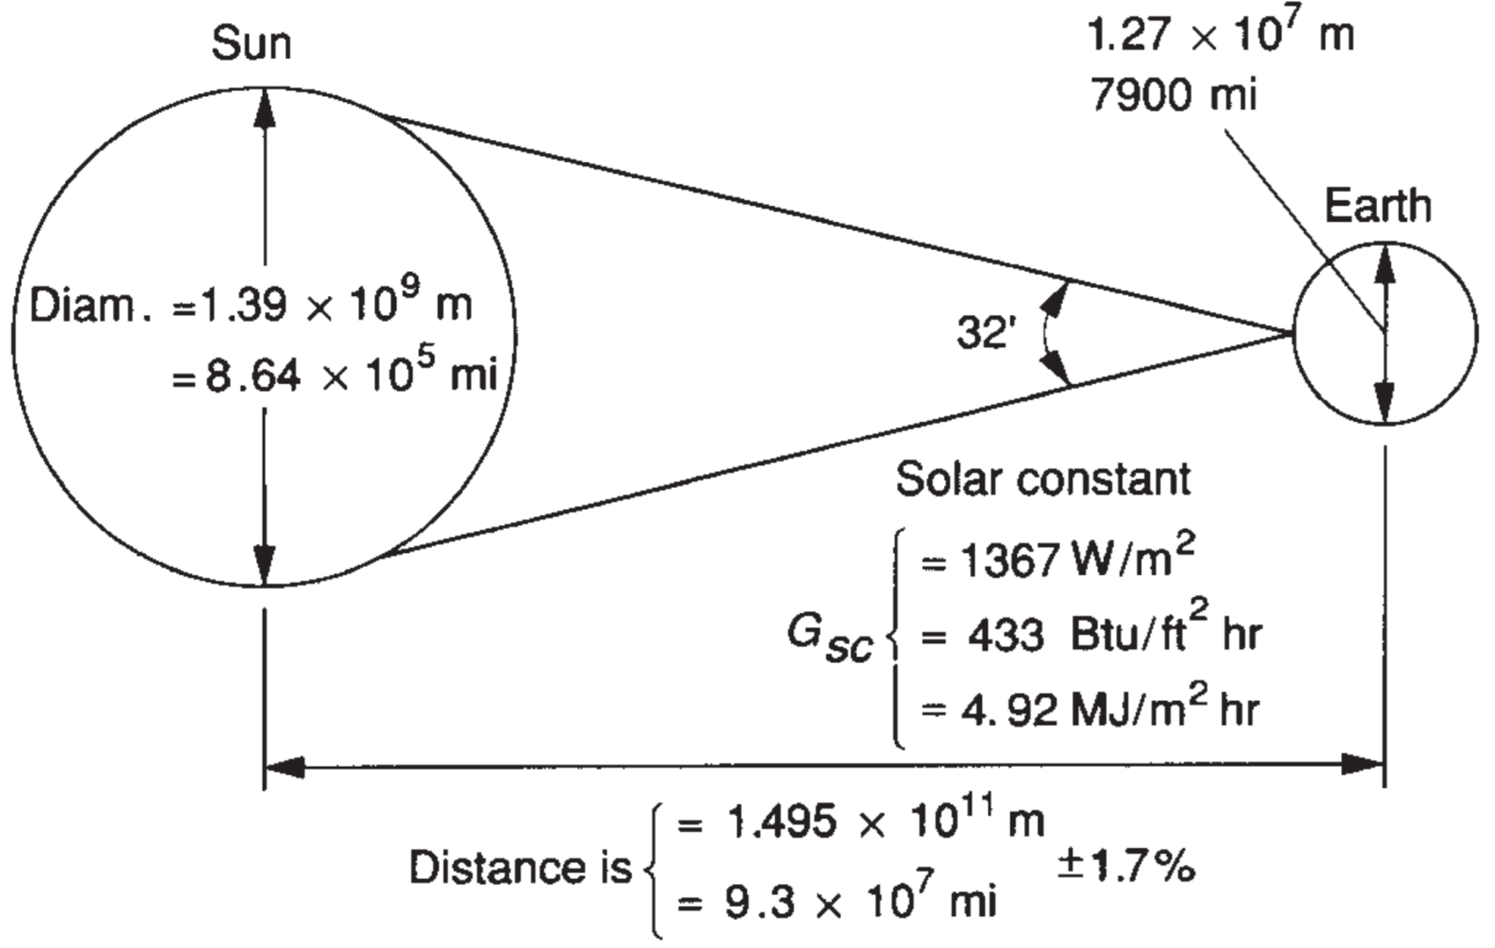
The solar constant Gsc is the energy from the sun per unit of time received on a unit area of surface perpendicular to the direction of propagation of the radiation at mean earth-sun distance outside the atmosphere.

Slide 4

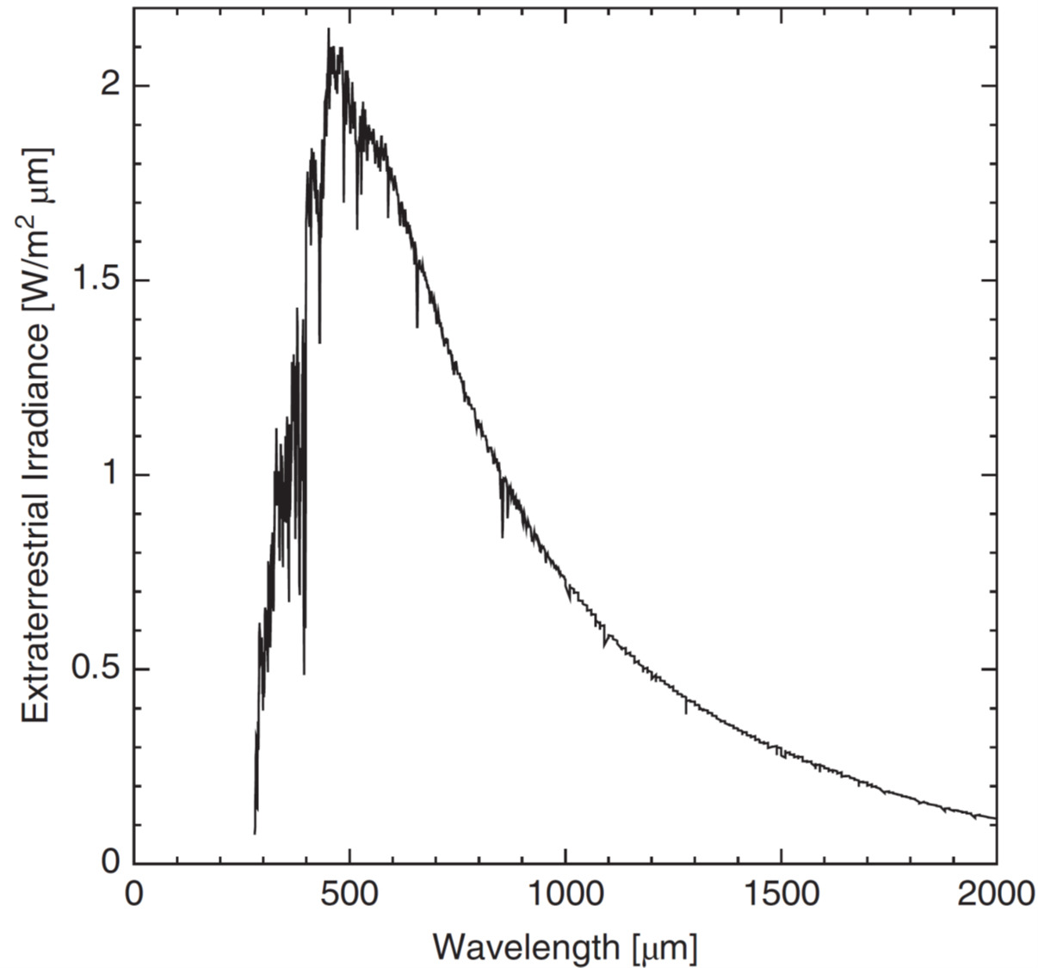

Slide 5
Variation of the earth-sun distance leads to variation of extraterrestrial radiation flux in the range of ±3.3%.

Slide 9
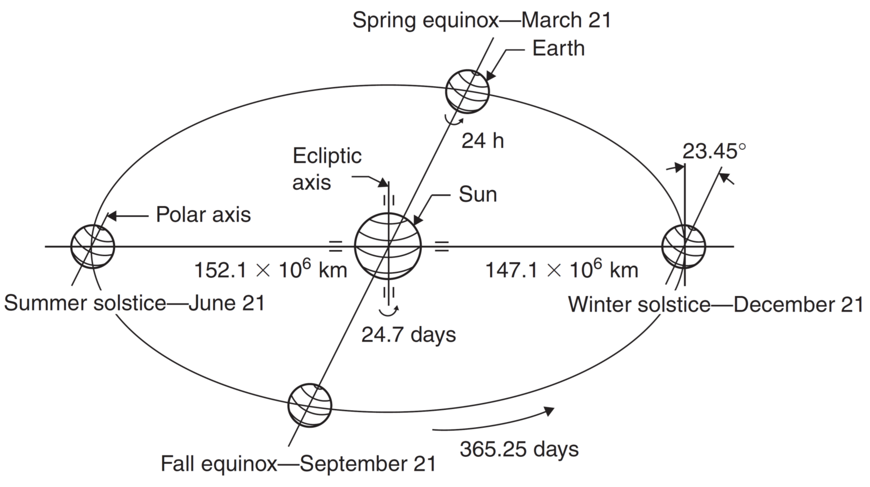
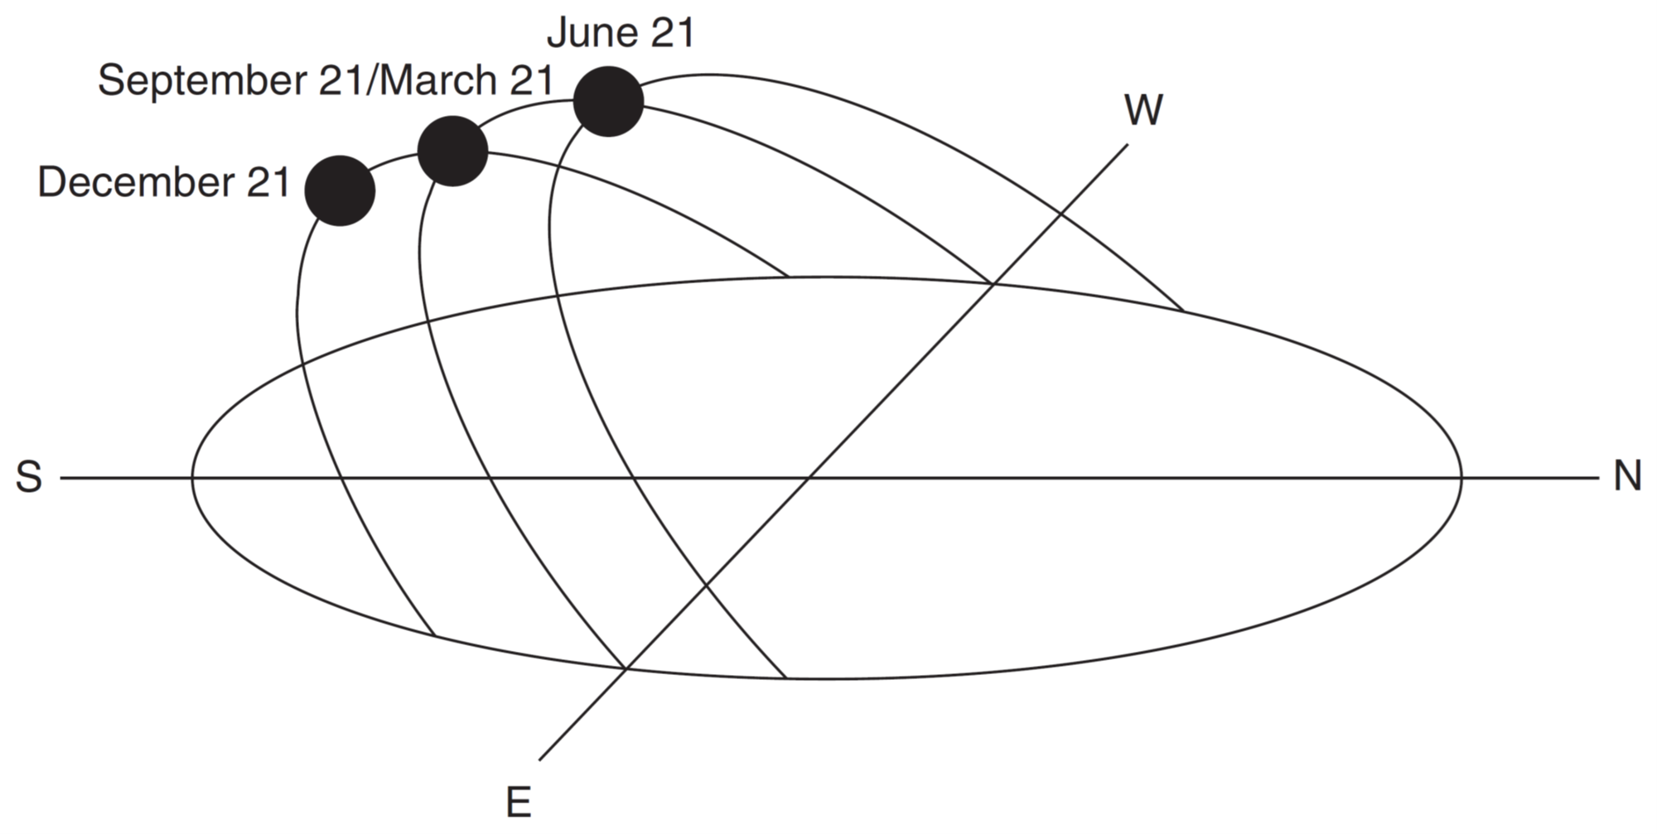

Slide 10
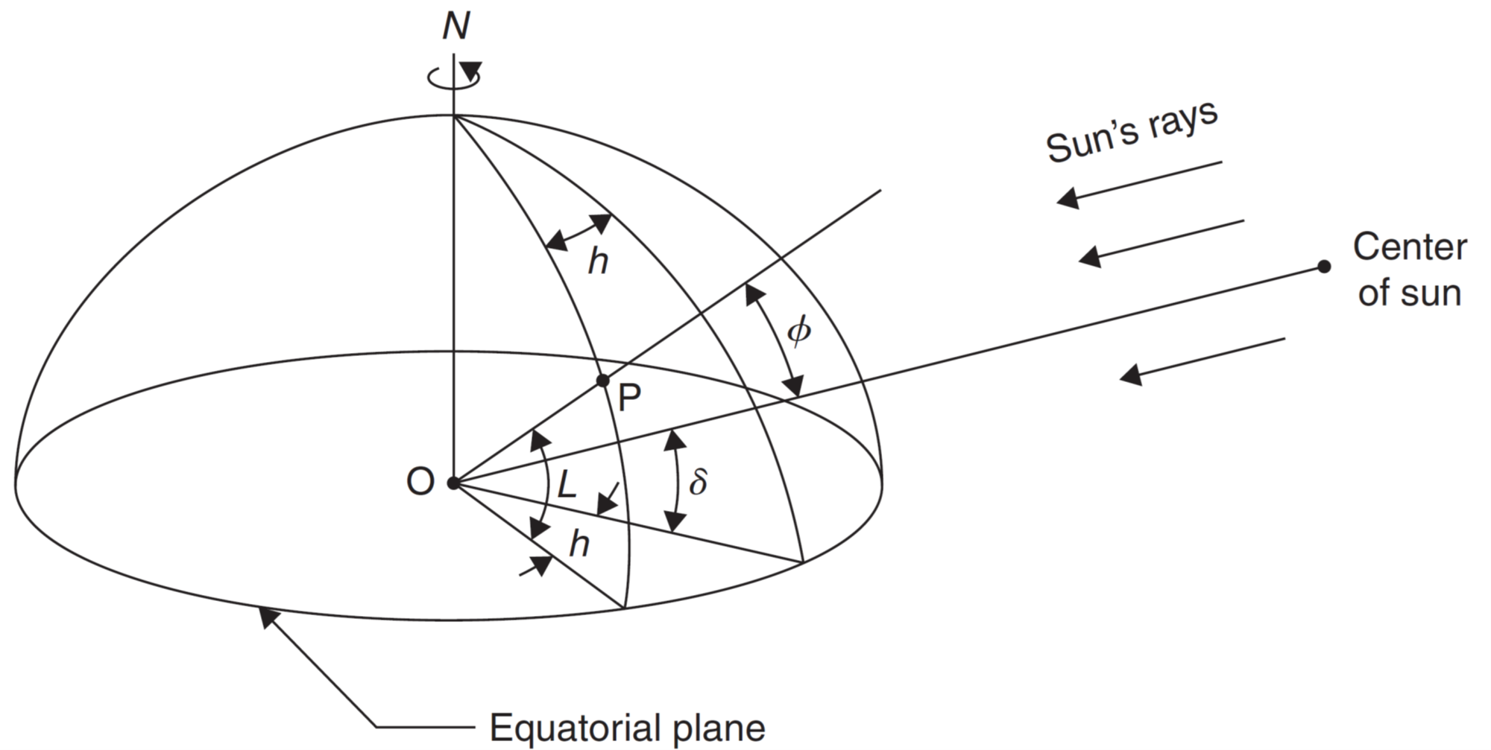
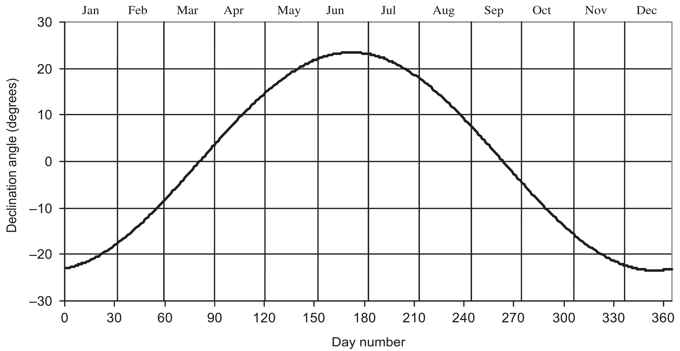
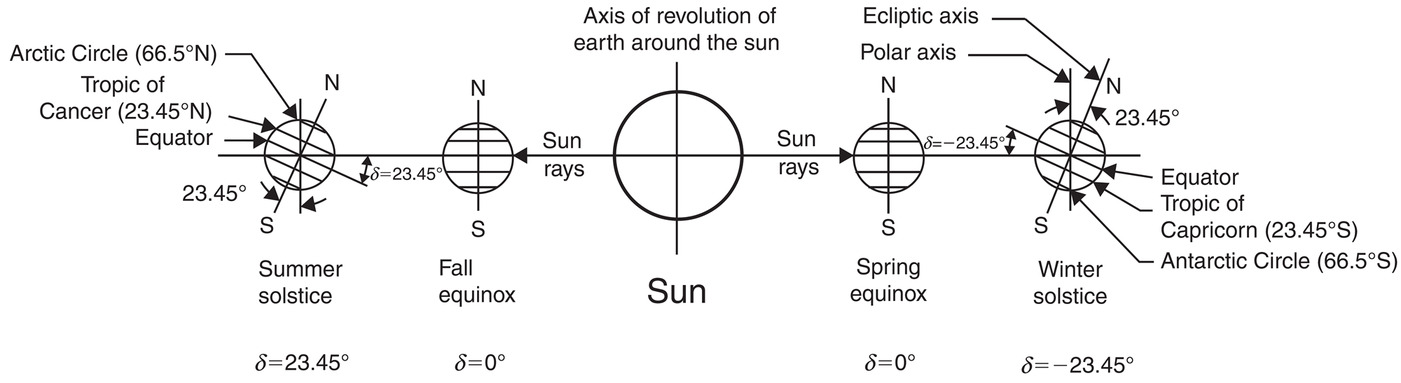

Slide 11
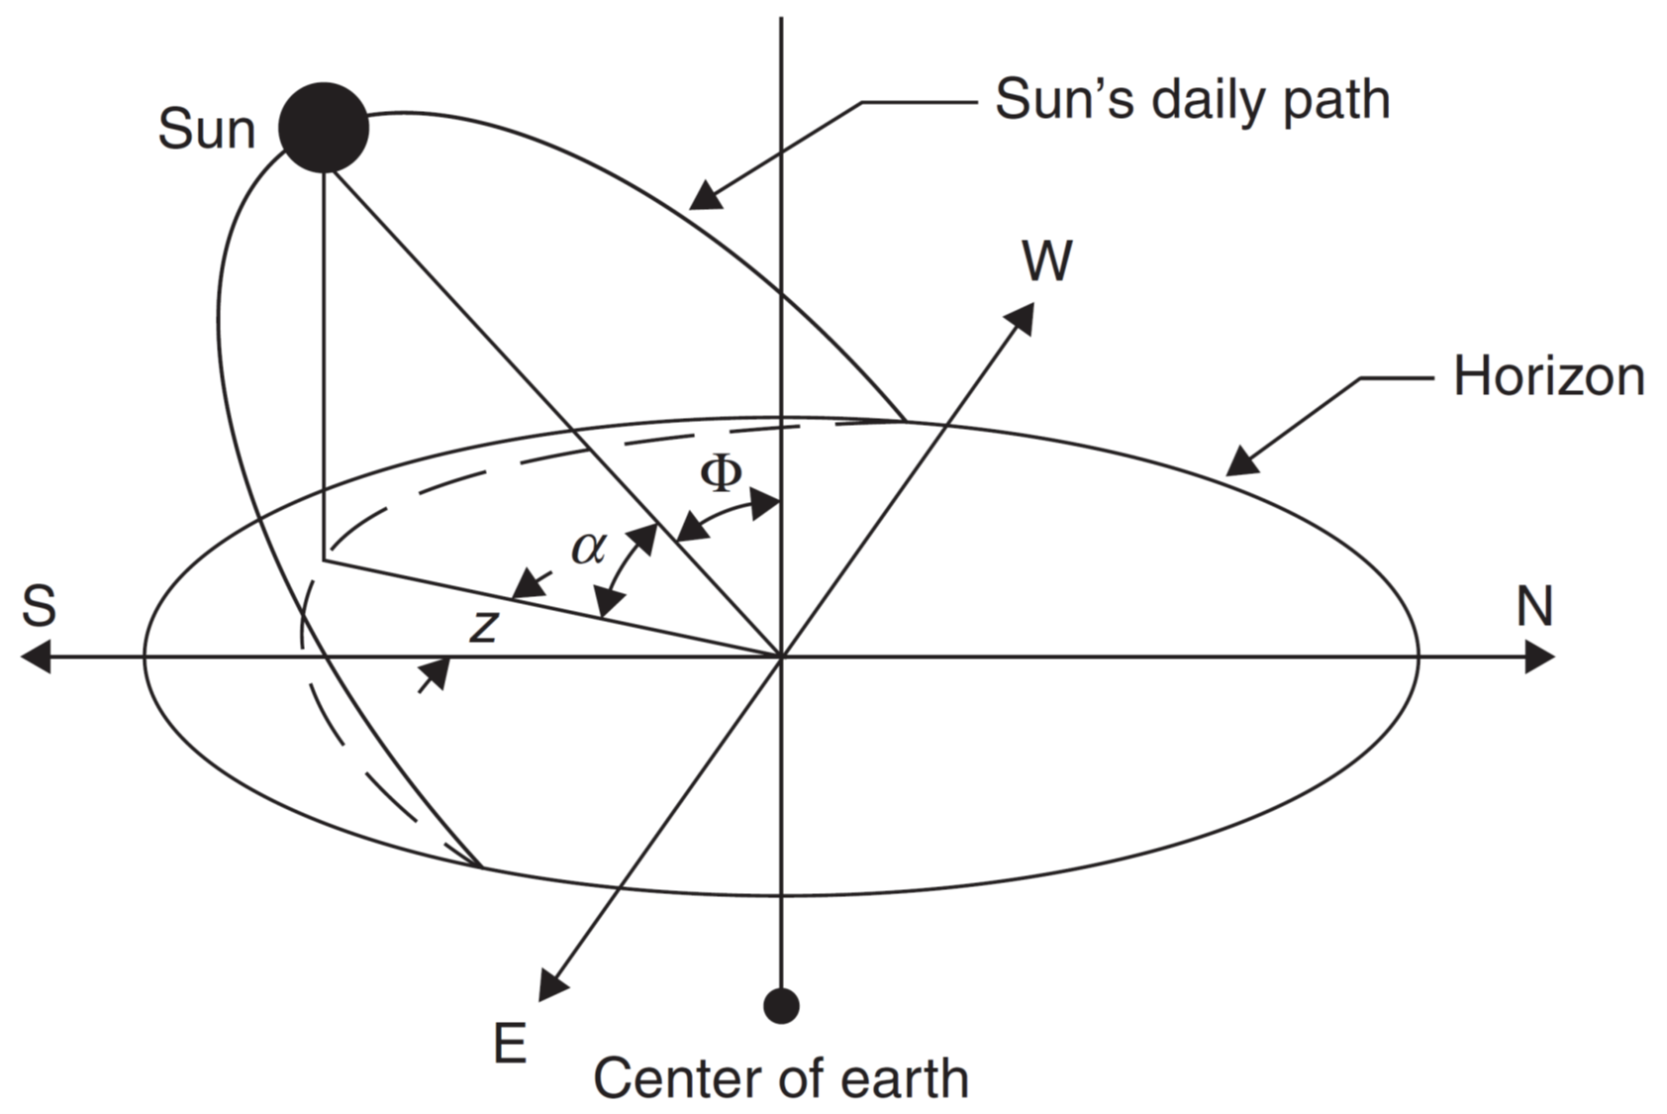

Slide 12
